Slide 1

DURGA MAHAVIDYALAYA, RAIPUR (cg)
8 cG GIRLS BN, NCC
NCC ACTIVITIES YEAR- 2018-2019
CAPT(DR) ARCHANA GOMASTA
ASSISTANT PROFESSOR & ASSOCIATE NCC OFFICER

Slide 2
YEAR WISE ENROLLED STRENGTH COMPANY NO-2, PLATOON-A
ORTHRISED STRENGTH | ENROLLED STRENGTH | 1ST YEAR | 2ND YEAR | 3RD YEAR
56 | 56 | 34 | 10 | 12

Slide 3
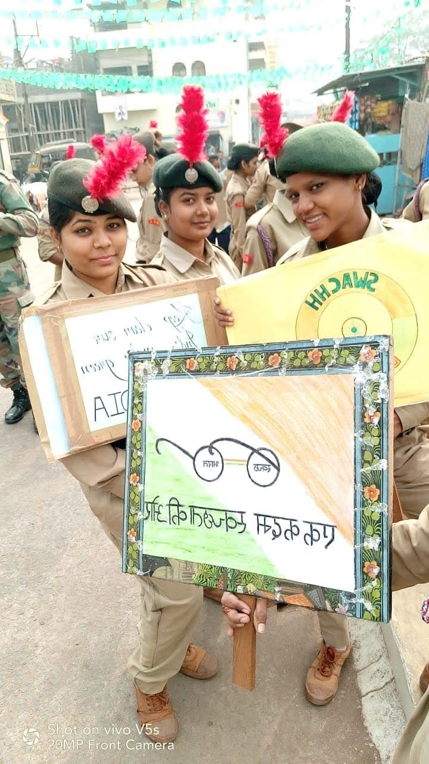
CARRIED OUT SWACHATA RALLY NEAR BY MOUDHAPARA SLUM AREA AT RAIPUR on september10th 2018

Slide 4

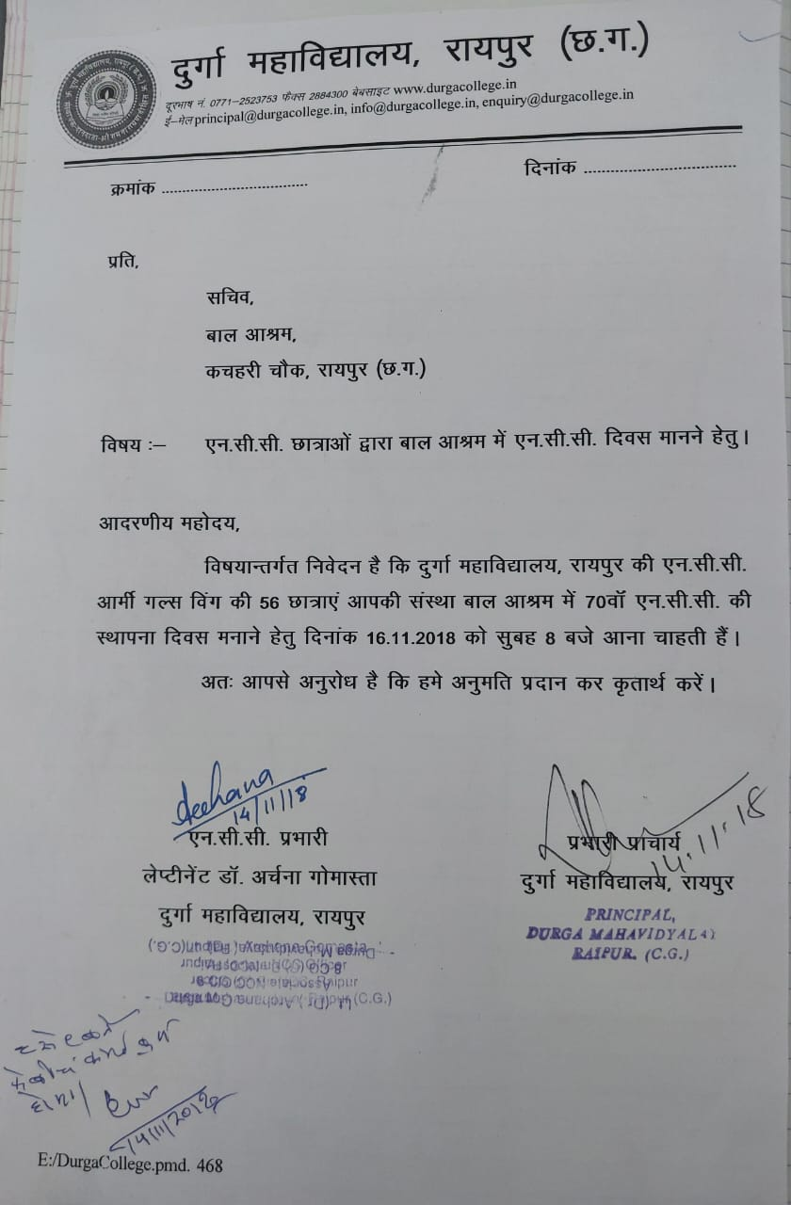
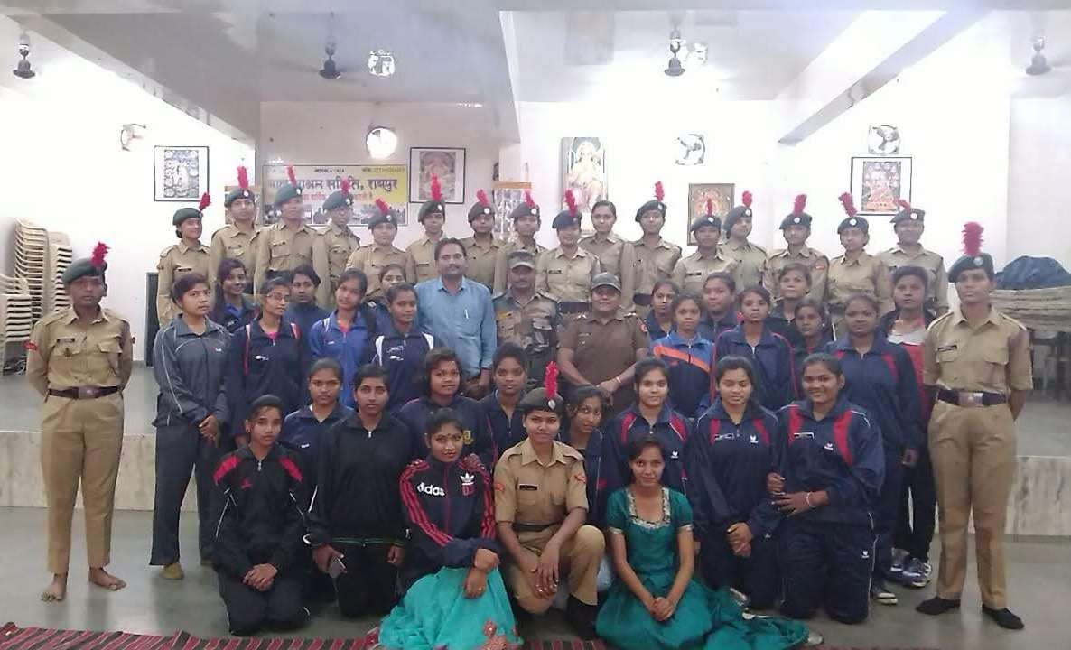
CELEBRATED NCC Day at bal ashram NEAR KACHARI CHOWK RAIPUR ON NOVEMBER 14th ,2018

Slide 5
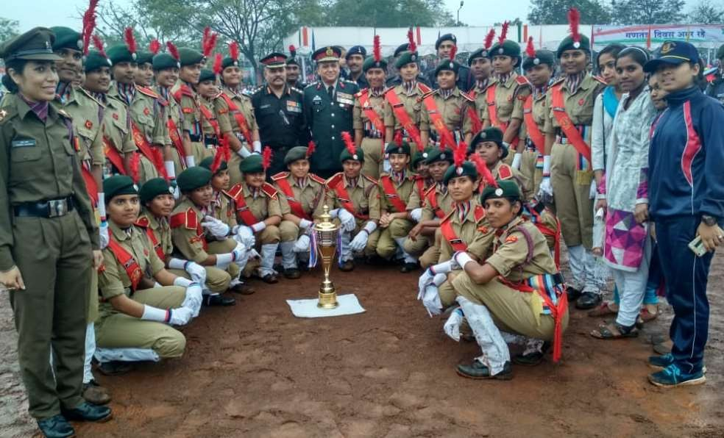
REPUBLIC DAY CELIBRATION ON JANUARY 26TH, 2019
26th January 2019, parade at police ground.
Parade marched infront of CM Honorable Shri Bhupesh Baghel.
3 cadets from our college were selected for the event.
8CG(G) BN has won first prize.

Slide 6
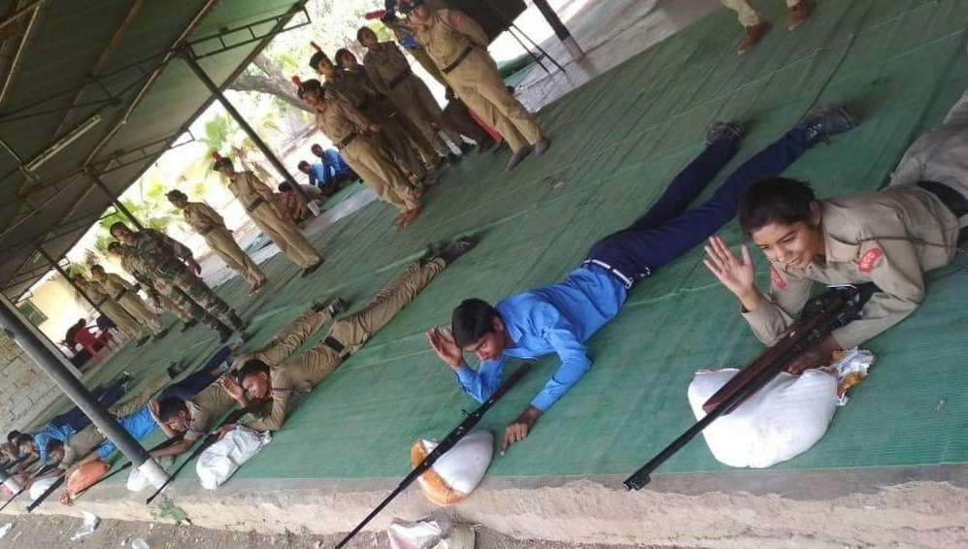
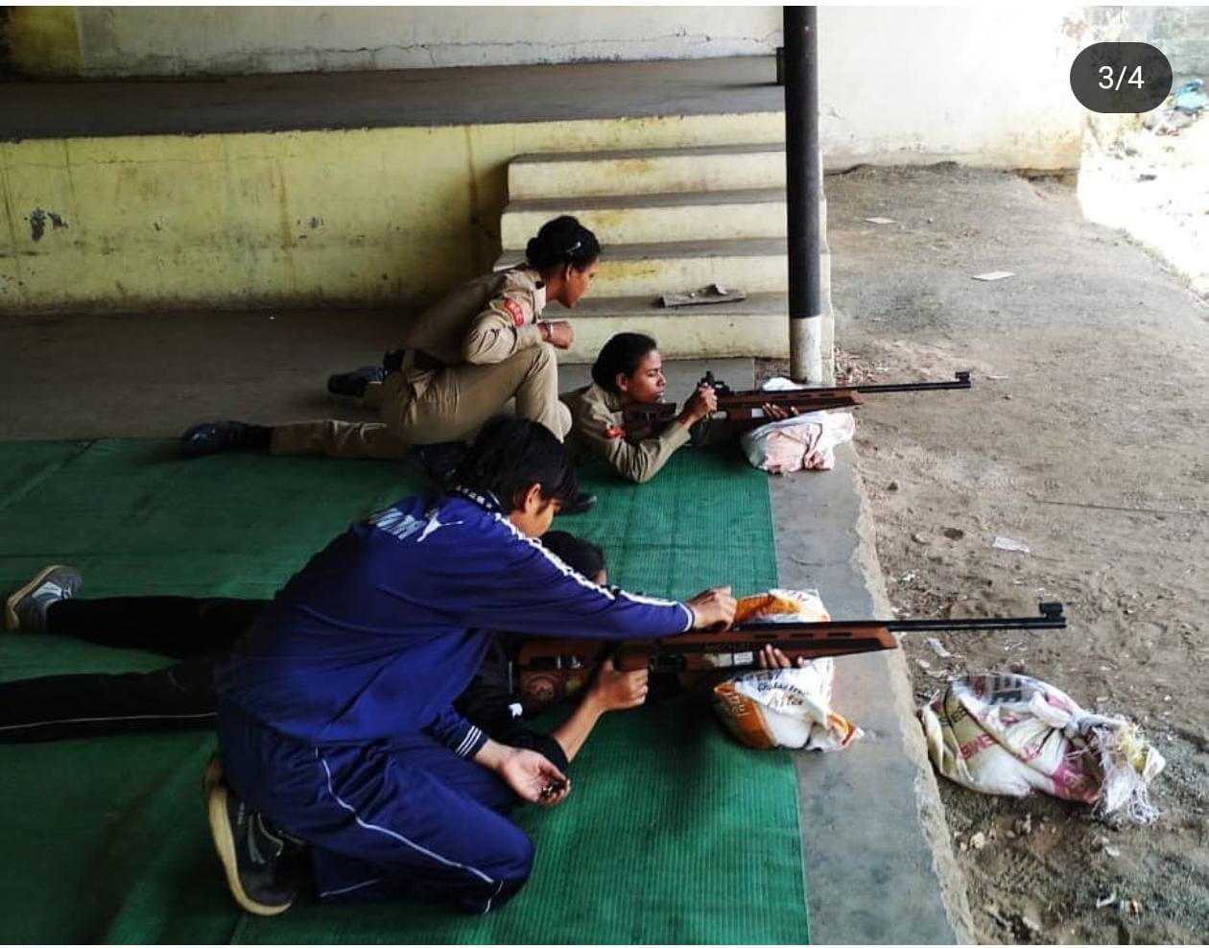
WEAPON TRAINING DURING MOWALANKAR CAMP SELECTION AT MANA, RAIPUR on may, 2019

Slide 7
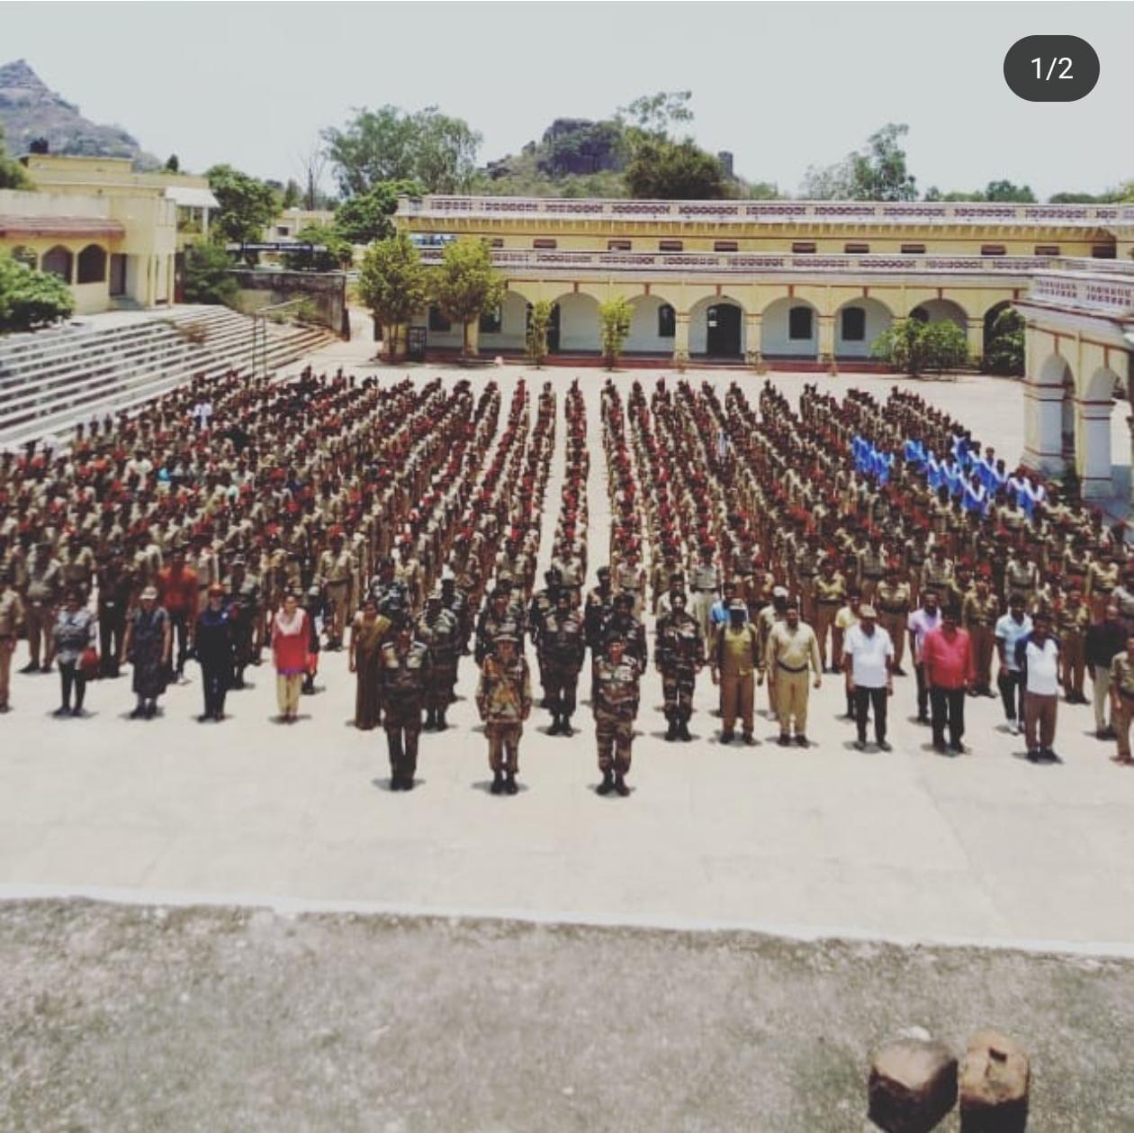
EK BHARAT SHRESTH BHARAT CAMP (National integration camp) HELD AT INDORE MP

Slide 8
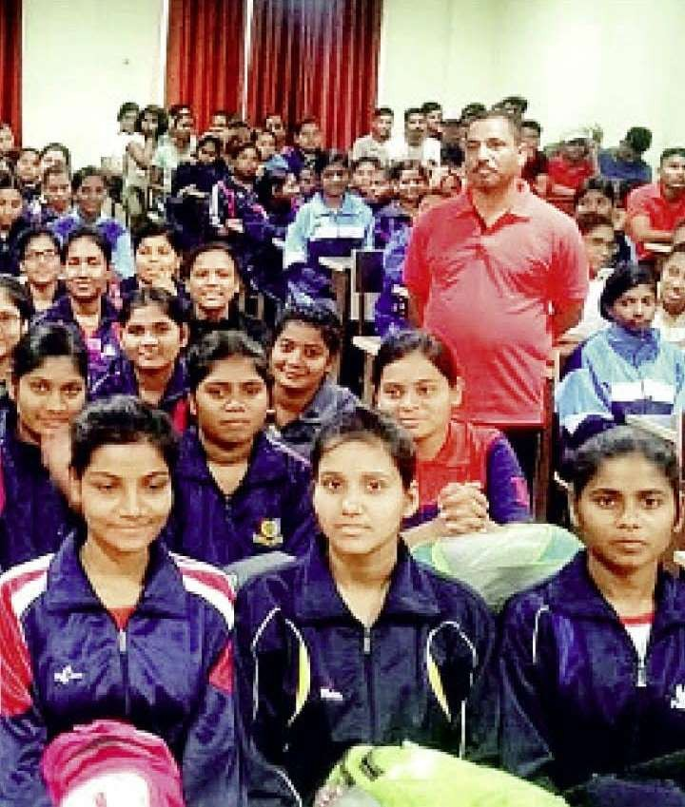
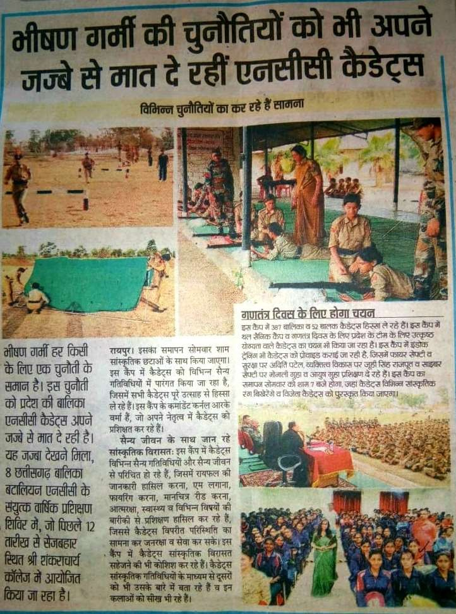
Camp ACTIVITIES May, 2019
Combined Annual Training Camp

Slide 9
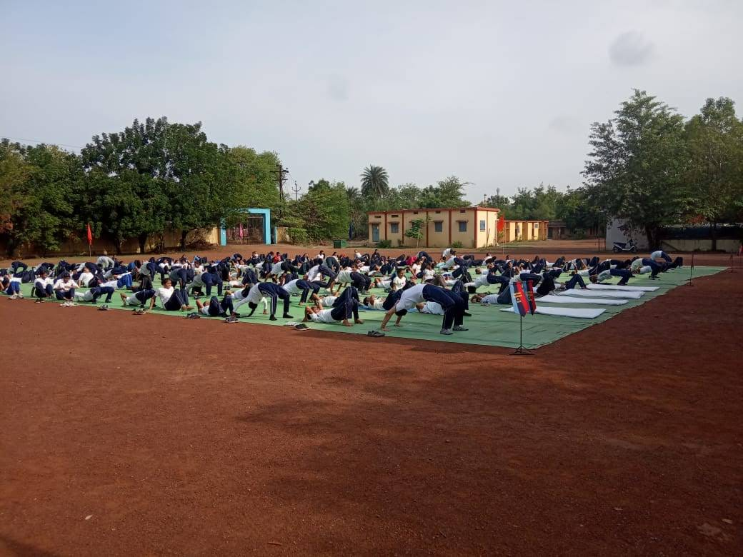
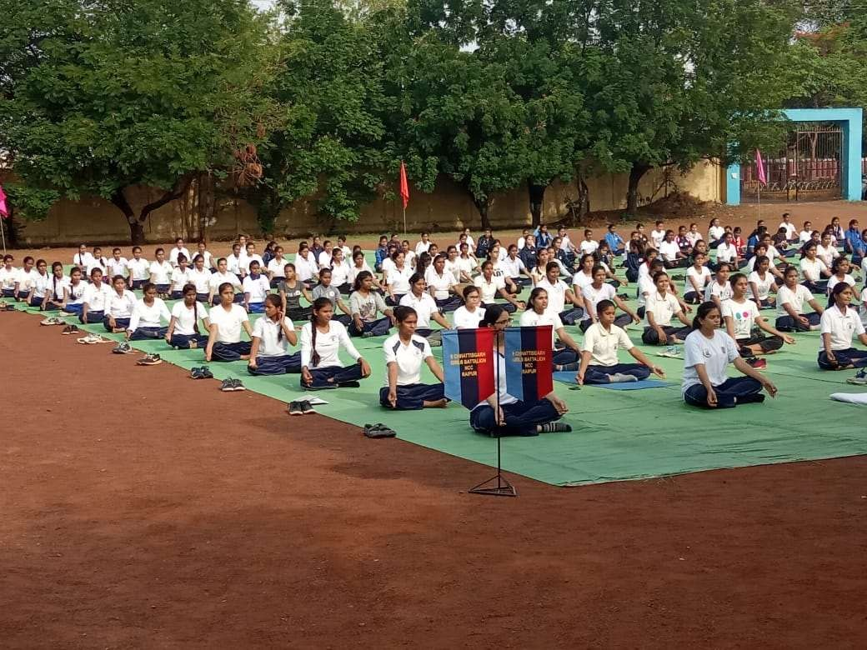
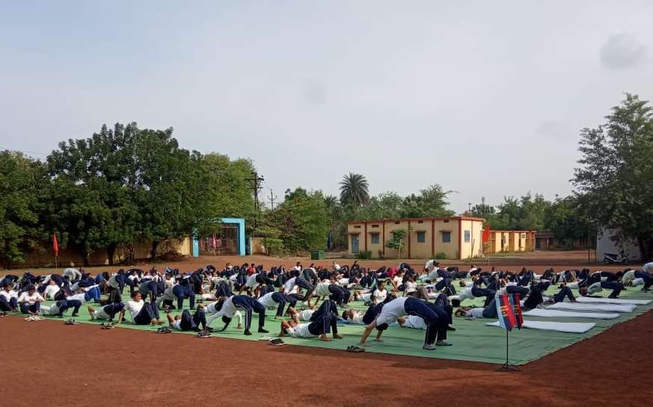
Celebrated International Yoga Day At govt jagganath rao dani hh school, raipur ON june 21st ,2019

Slide 10
JAI HIND

